Slide 1
How Government Spending Effects Student Test Scores
DATE: 4/14/2025
Jacob Rasmussen, Sage Steelman

Slide 2

Context
President Trump's executive order to dismantle the Department of Education has prompted a lot of uncertainty regarding the welfare of public-school students. As President Trump attempts to cut federal spending across the board, the question arises as to whether a decrease in federal spending on education will adversely affect student test scores.

Slide 3
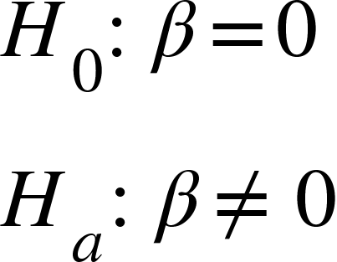
Hypothesis
The basis of our hypothesis is simple. The null hypothesis is that there is no relationship between the amount of money a government spends per student, and PISA test scores. The alternative is that there is some kind relationship. We anticipate it will be positive, but we will let it be a double-sided hypothesis test on the off-chance there is a negative relationship.

Slide 4
Methods
To test our hypothesis, we will regress government spending per person and spending on education as a percentage of GDP on each countries average PISA scores. We will test whether the coefficients of the equation are significant at 95% significance levels.

Slide 5
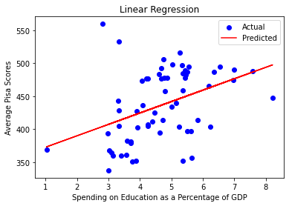
Spending as a Percentage of GDP
The first factor we tested was spending as a percentage of GDP. The intuition behind this being that a country who diverts a larger percentage of their resources towards education will generally have a better education system. However, this factor does not take into account how strong a economy is. So, a country might spend a large percentage of their GDP on education, but if their GDP is low to begin with, they might still be spending very little on education. With that being said there is a positive trend when doing a linear regression. We will need to determine whether it is significant still.

Slide 6
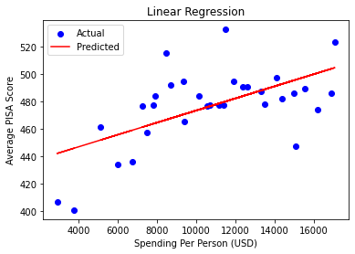
Spending Per Person
Regressions on Spending per person against PISA score reveal a similarly positive correlation. Just based off the eye test, it appears as though this regression fits the data better. With few major outliers, countries who spent more money per student achieved higher test scores. This model does not suffer from the same shortcomings as the previous model. Spending Per Person does not rely on the strength of the countries economy. It is a more objective measure.

Slide 7
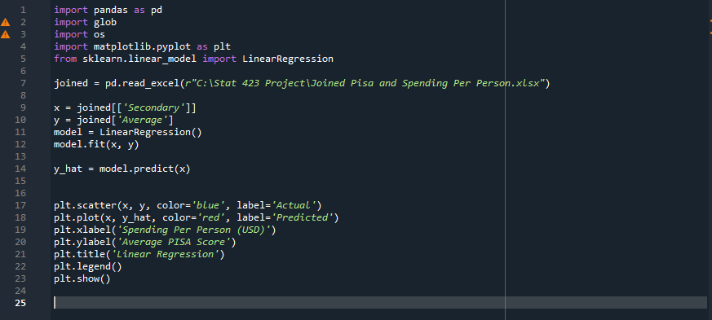
Script

Slide 8
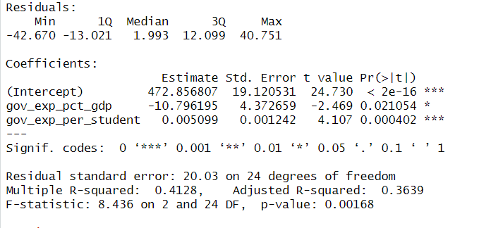
Test in R
After running the test in R, we found that both the percentage as a gdp and the spending per student on average are significant predictors at a 95% significance level.

Slide 9
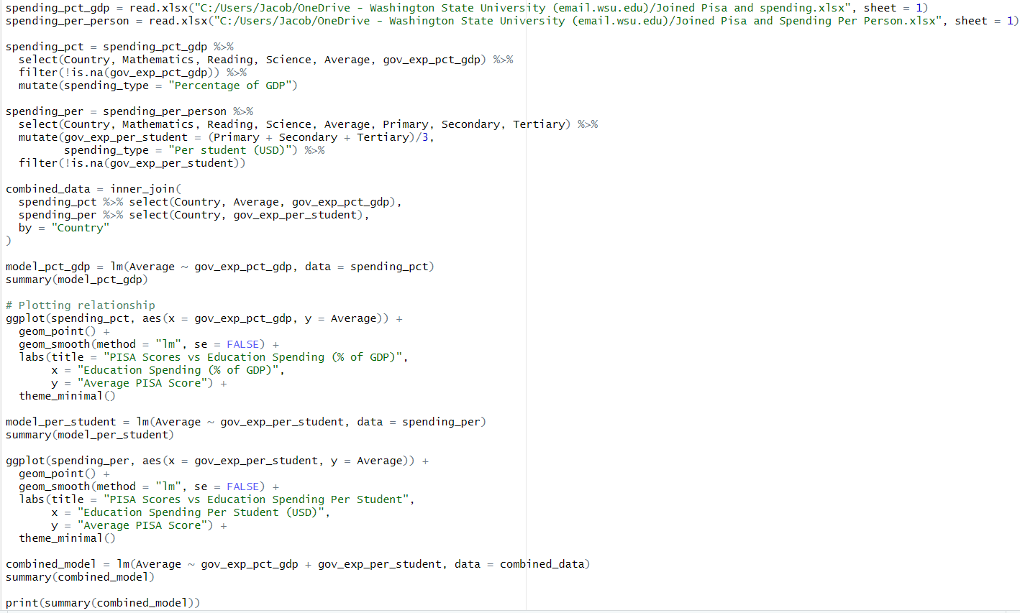
Script
R

Slide 10
Conclusion
After running the Python test we were able to see the positive relationships between the spending as a percentage of gdp and the spending per student with the PISA scores. Once we ran those tests, we then ran a test in R to find if the positive relationships were significant at a 95% significance level which we were able to do as both were significant. This means that the more spending a country did on education, the higher their PISA scores were. Thus, we rejected our null hypothesis that there is no relationship between the spending and the PISA scores.

Slide 11
Works Cited
OECD (2024), Education at a Glance 2024: OECD Indicators, OECD Publishing, Paris, https://doi.org/10.1787/c00cad36-en.
PISA 2022 Database. (2024). OECD. https://www.oecd.org/en/data/datasets/pisa-2022-database.html#data
World Bank: Education Data. (2019, March 20). Kaggle. https://www.kaggle.com/datasets/theworldbank/world-bank-intl-education
Government expenditure on education, total (% of GDP). World Bank Open Data. (n.d.). https://data.worldbank.org/indicator/SE.XPD.TOTL.GD.ZS
PISA scores by country 2025. Data Pandas. (n.d.). https://www.datapandas.org/ranking/pisa-scores-by-country

